Slide 1
Helicopter Money and Blockchain
In the European Community

Slide 2
Proposed Question
How can Blockchain Technology offer a better approach to deploy Helicopter money to Citizens?

Slide 3
3 key assumptions to prove
Assumption 1: Helicopter money offers a viable alternative to quantitative easing during a crisis
What research exists both for and against this?
What case studies (countries or otherwise) exists?
Assumption 2: There are challenges with the distribution of helicopter money
What are these challenges?
Why do they exist?
How are they made? By whom? When?
What criteria do we need to rapidly distribute Helicopter Money?
Assumption 3: These challenges can be solved with Blockchain Technology
How do we prove it?

Slide 4
Around the EU
'nothing in EU law rules out the so-called ‘helicopter money’ idea whereby the ECB would directly transfer money to all citizens.'
https://www.euractiv.com/section/economy-jobs/opinion/why-the-ecb-needs-to-look-at-helicopter-money-now/
Mario Draghi, ex-President ECB said,
‘in the absence of any serious prospect for a large fiscal stimulus, “helicopter money” is certainly the most effective form of monetary policy that is left available to the ECB today’

Slide 5
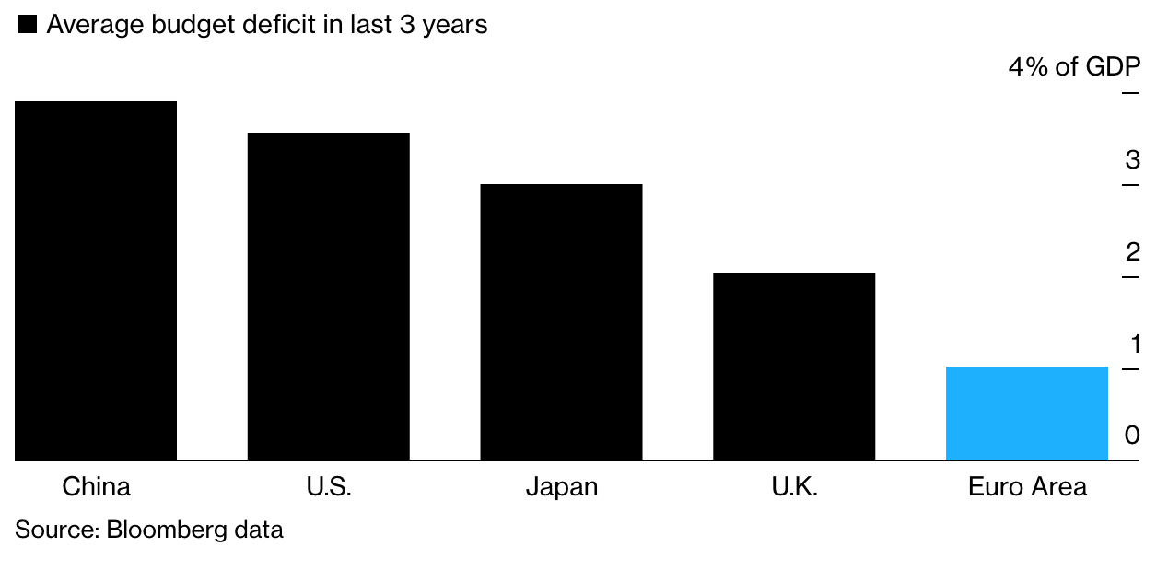
EU vs Others in Financial Aid
https://www.bloomberg.com/news/articles/2019-09-24/draghi-is-open-to-helicopter-money-but-europe-is-a-no-fly-zone

Slide 6
Challenges of Helicopter Money
Equality vs Equity
Helicopter money is also a blunt tool. It helps the rich as much as the needy and would not do much for businesses whose customers are staying home, like restaurants and hotels.
Essentially, Helicopter Money is just carpet bombing people with money. This means that when blindly dropping money you could be:
1. Giving money and relief to those who don't need it (the rich) 2. Helping but not enough, those who need it 3. Not making any difference at all

Slide 7
Other risks of Helicopter Money
Asset Bubbles
Currency Wars
Political Friction and Populism
Decreased spending and more capital saving

Slide 8
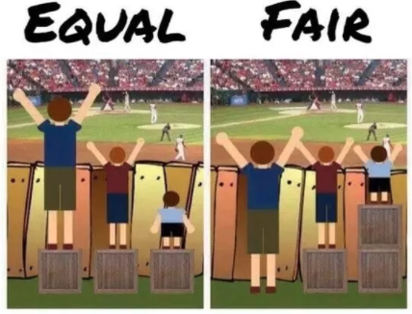

Slide 9
Challenges Blockchain could Solve
Calculate eligibility for Helicopter Money
Make sure payout is received and received only once
No abuse
Money is spent on perishable goods or supplies that stimulate economy
It does not end up in the hands of bigger businesses (more expensive services, rents etc…)
Can Smart Contracts represent the eligibility and distribution of Helicopter money?

Slide 10
JH

Slide 11
Definition: Helicopter money
Assumption 1: Helicopter money offers a viable alternative to quantitative easing during a crisis
Avoids the problems associated with money creation by private banks and distribute money directly to the people
Can be created by the central bank paying reserve money into banks’ account with the instruction to banks to create book money against it
Would allow debt reduction and raise aggregate demand
Would facilitate the change-over from our present credit money system to an alternative money system, in which money is no longer created as private debt but as an asset backed by the reputation of the issuer. Crypto money technology would be well suited for the creation of and payment with reputation money

Slide 12
Objections to helicopter money
Assumption 1: Helicopter money offers a viable alternative to quantitative easing during a crisis
Competencies. It could be stated that individuals, on average, do not have the necessary financial education that can lead to an optimal choice of consumption. On the other hand, conventionally the Central Bank has always dealt directly with the banking system and 57 financial institutions. Despite the knowledge and the specialization, the financial sector was not always able to reach efficient results.
Inflationary effect. The idea that usually is associated with more money handed directly to the households is high inflation. It is also true that the Central Bank does inject liquidity in the system in “normal” times, and most importantly, a solid policy on prices should include several other factors such as the variation of debt and the amounts of investments.
Worsening of the crisis. The author fights back the concept that sees the highest risk in case of exclusion of private investments, by stating that it is the aggregate demand the true core of the economy, thus with its push (that would be fine-tuned by the helicopter policy) it is possible to move towards stability.

Slide 13
For it to work
Assumption 1: Helicopter money offers a viable alternative to quantitative easing during a crisis
Three conditions must be satisfied for helicopter money to boost aggregate demand:
There must be benefits from holding fiat base money other than its pecuniary rate of return.
Fiat base money is irredeemable - viewed as an asset by the holder but not as a liability by the issuer.
The price of money is positive.

Slide 14
Case studies (rest of world)
Assumption 1: Helicopter money offers a viable alternative to quantitative easing during a crisis
Country | Amount per citizen | Amount total | How | To | Misc. | Sources
Japan (1999) source | 20,000Â | 31Â million | Vouchers/coupons |  | •In 1999 •Expired after 6 months •Had a positive effect on spending on semi-durables, but no effect on spending on nondurables or services | Hsieh et al., 2010
Hong Kong (2020) | $1,200 | $15bn | Cash | Permanent residents 18+ | •Along with with a full guarantee on loans taken out by companies to pay wages and taxes | Financial Times
Macau (2020) | 3000 patacas | $274.9m (2.2 billion patacas) | Vouchers/coupons | Permanent residents | •Each given a card with a stored with value valid for three months •300p cap per transaction •The permanent residents will also get an extra medical coupon worth 600 patacas this year | CNBC SCMP
Singapore (2020) | $100 to $400 | part of a $1.6 billion | Cash | Singaporeans | •Singaporeans aged 21 and above to get one-off cash payout of up to $300 •Parents get $100 extra •Income and property ownership-based •$100 top-up to the PAssion cards of all Singaporeans aged 50 and older this year. | Straits Times CNBC
United States (2020?) | $1000+ | Part of wider $850bn package | n/a | Citizens | •White House said it was preparing to send the payments to Americans | The Guardian CNBC

Slide 15
How would it be spend (1/2)
Assumption 1: Helicopter money offers a viable alternative to quantitative easing during a crisis
Research shows that respondents expect to spend about 30% of the helicopter money transfer and it would hardly affect inflation expectations.
Furthermore, whether transfers come from the central bank or the government makes no difference.
Finally, our results suggest that the effect of helicopter money on public trust in the ECB is ambiguous.

Slide 16
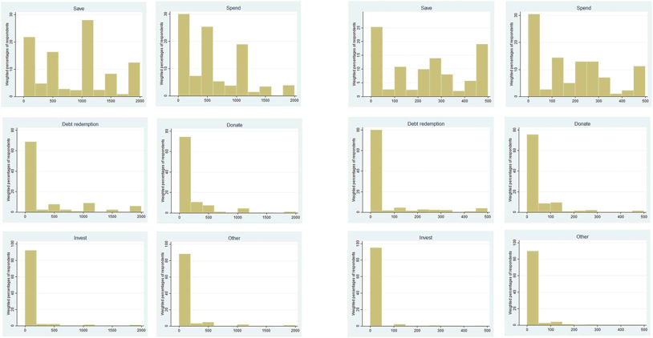
How would it be spent (2/2)
Assumption 1: Helicopter money offers a viable alternative to quantitative easing during a crisis
Distribution of allocation of transfer from ECB: €2000 (left) and €500 (right)

Slide 17
Some research conclusions:
Assumption 1: Helicopter money offers a viable alternative to quantitative easing during a crisis
The two funding advantages of fiat base money: zero nominal interest rate and irredeemability
Helicopter money drops always boost demand

Slide 18
How it can be distributed? (1/2)
Assumption 2: There are challenges with the distribution of Helicopter Money
It can be implemented via transfers to households and businesses via a tax cut coupled with incremental purchases of government debt, so that the tax cut is in effect financed by money creation.
Because of a strict ban on funding of government deficits and the absence of fiscal policy coorindation in the euro area, the ECB would hardly be in a position to inject money through government accounts … but instead … it could be distributed through private bank accounts

Slide 19
How can it be distributed (2/2)
Assumption 2: There are challenges with the distribution of Helicopter Money
With helicopter money the Central Bank would have two options to stimulate aggregate demand, bypassing the latter technical obstacle:
It could hand the funds to the Government, that in turn will use them to fund public works such as infrastructures
It could use the Government as an intermediary: it will hand in the money directly to the household and will follow the criteria specified by the central bank.

Slide 20
Challenges with distribution
Assumption 2: There are challenges with the distribution of Helicopter Money
It is clear that there are numerous practical implementation challenges in adopting such a policy, including the need to determine (quickly) the size of transfer to which each firm would be entitled.
Such an intervention is likely to be considered illegal in many jurisdictions.
Legal issues aside, it is clear that a recurrent use of such policies by governments could be a source of an inflation bias and bring about changes in individual behaviour likely to undermine their effectiveness.

Slide 21
Who implements?
Assumption 2: There are challenges with the distribution of Helicopter Money
Helicopter money is a form of fiscal policy. The question arises of whether it is the central bank, the Treasury or both in coordination that should implement it. This has the potential to threaten the principle of central bank independence or at least it may force us to reconsider the rules that govern the relation between Treasury and central banks today.

Slide 22
Further challenges
Assumption 2: There are challenges with the distribution of Helicopter Money
Central banks remunerate the reserves with the final aim of the setting of the interest rate.
The effective control of the reserves is not in the hands of the central bank, but it is uniquely determined by the demand of the public; the actual setting regards the interest rate, thus promising an everlasting expansion of the monetary base is not credible.
The distribution of funds lies in the spectrum of action of the fiscal policies, while central banks can only pursue monetary policies.

